Slide 1

OBE briefing for students
How much can you learn about OBE?
Prepared by:
OBEC, LKC FES

Slide 2

What is OBE?

Slide 3


OBE is Outcome-Based Education.
OBE is an approach that focuses on the attainment of learning outcomes.
It focuses on what is essential for students to be able to do successfully at the end of their learning experiences.

Slide 4
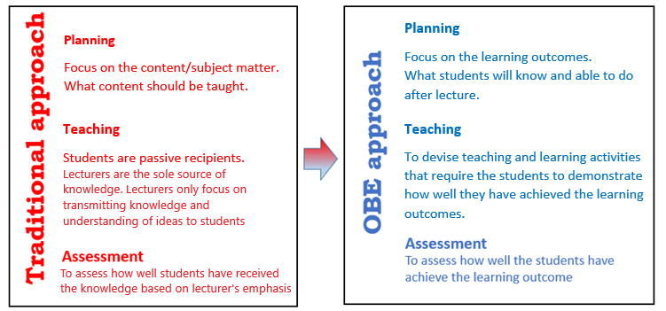
Why is OBE needed?
OBE is a systematic approach in curriculum delivery that focuses on a set of intended goals.
Based on student-centered learning philosophy that focuses on empirically measuring student performance, which are called outcomes.
An approach that fosters the spirit of Continuous Quality Improvement (CQI)
4
Notes:
.

Slide 5






Also, OBE is a requirement from qualification bodies / professional bodies such as MQA, MOHE, BEM, EAC, LJBM and MBOT

Slide 6
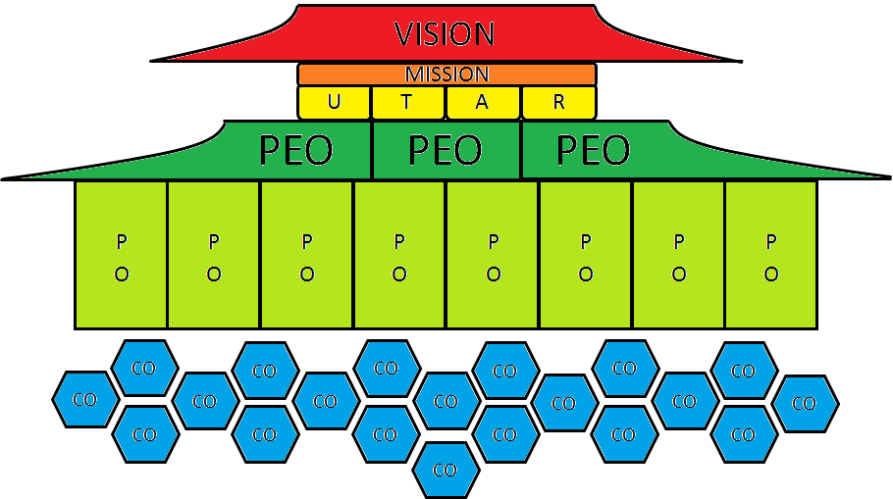
UTAR OBE framework
Professional Level
Programme Level
Course Level

Slide 7
Vision of UTAR:
To be a global university of educational and research excellence with transformative societal impact.
Mission of UTAR:
Universal values in our beliefs (M1)
Tenacity and resilience in overcoming challenges (M2)
Agility in facing new frontiers (M3)
Responsibility and commitment in pursuit of excellence (M4)

Slide 8
What are the Outcomes?
Programme Educational Objectives (PEOs) describe the career and professional accomplishments of graduates within 3-5 years after graduation.
Programme Outcomes (POs) describe the abilities or skills (cognitive, psychomotor and affective) that students can demonstrate at the time of graduation.
Course Outcomes (COs) are specific statements of what students are expected to KNOW and be able to PERFORM at the end of the course.
The abbreviation CO and CLO can be used interchangeably for Course Learning Outcome.
Similarly, the abbreviation PO and PLO can be used interchangeably for Programme Learning Outcome

Slide 9
Programme Educational Objectives (PEOs) describe the career and professional accomplishments of graduates within 3-5 years after graduation.
The PEOs of Bachelor of Science (Honours) Applied Mathematics with Computing
are to produce:
PEO 1: Graduates who are competent in problem solving in a variety of industries using mathematical and computational methods.
PEO 2: Graduates who are capable of taking management roles and communicating effectively with other players in their industries.
PEO 3: Graduates practising professional ethics, life-long learning, responsible decision making, accountabilities for the betterment of the profession and society.

Slide 10
Programme Outcomes (POs) describe the abilities or skills (cognitive, psychomotor and affective) that students can demonstrate at the time of graduation.
PO1
Knowledge and understanding
PO5
Communication skills
PO9
Personal skills
PO3
Practical skills
PO7
Numeracy skills
PO11
Ethics and professionalism
PO2
Cognitive skills
PO6
Digital skills
PO10
Entrepreneurial skills
PO4
Interpersonal skills
PO8
Leadership, Autonomy and Responsibility
PO8
Leadership, autonomy and responsibility

Slide 11
Mapping of PO to PEO
PEO | Programme Outcomes (PO)
 | PO 1 | PO 2 | PO 3 | PO 4 | PO 5 | PO 6 | PO 7 | PO 8 | PO 9 | PO 10 | PO 11
PEO 1 | √ | √ | √ |  |  | √ | √
PEO 2 |  |  |  | √ | √ |  |  | √ |  | √
PEO 3 |  |  |  |  |  |  |  |  | √ |  | √

Slide 12
Course Outcomes (COs) are specific statements of what students are expected to KNOW and be able to PERFORM at the end of the course.
UECM1314 Fundamentals of Linear Algebra
CO1 - Solve linear systems with elementary row operations.
CO2 - Solve geometrical problems.
CO3 - Compute eigenvalues or eigenvectors of a matrix.
CO4 - Solve linear algebra problems related to vector spaces.
EXAMPLE

Slide 13
Mapping of CO to PO
CO | Programme Outcomes (PO)
 | PO 1 | PO 2 | PO 3 | PO 4 | PO 5 | PO 6 | PO 7 | PO 8 | PO 9 | PO 10 | PO 11
CO 1 | √
CO 2 | √
CO 3 | √
CO 4 | √
Each CO contributes to the achievement of PO via curriculum design, course delivery and assessment tasks that are most appropriate to attain that CO.

Slide 14
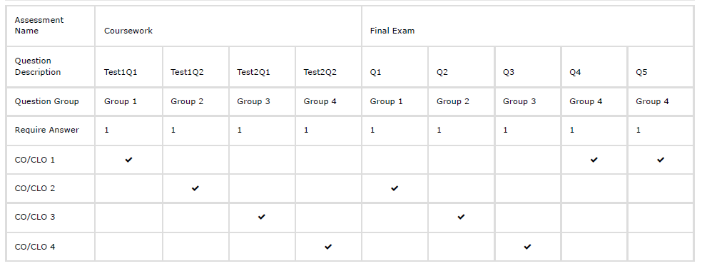
Assessment to CO Mapping
EXAMPLE
All COs will be assessed, regardless of students’ choice of answering optional questions in continuous assessment and final examination. Each assessment task/question is mapped to ONE CO only.

Slide 15
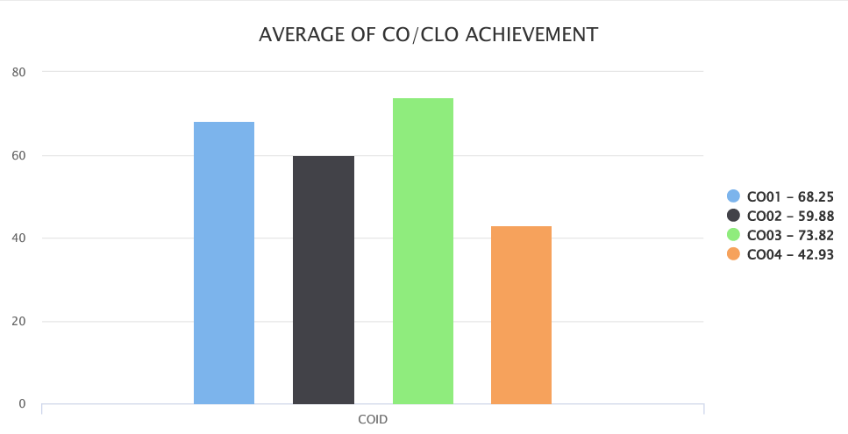
CO Achievement
(Performance indicator of students for lecturers to do Continual Quality Improvement on the course)
Target
50%
EXAMPLE

Slide 16
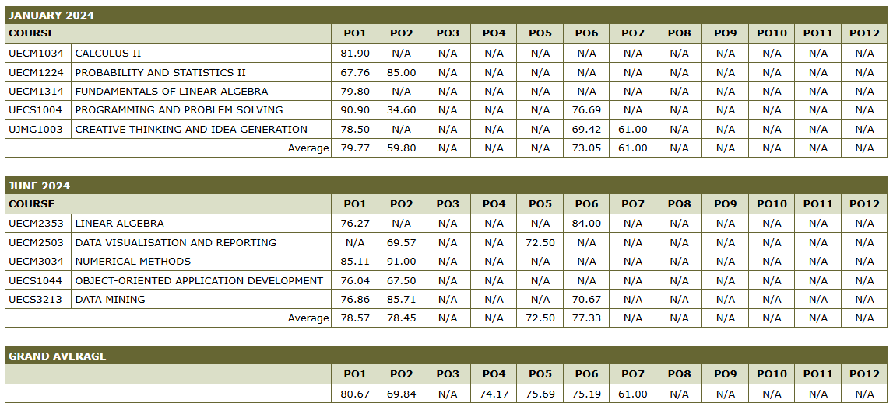
Individual PO Achievement (to date)
EXAMPLE
**You can check with your Academic Advisor every trimester on your accumulated PO scores.

Slide 17
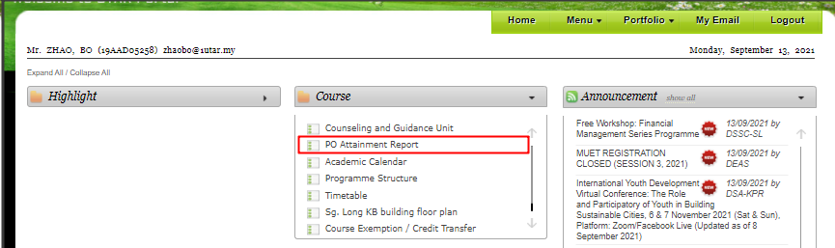
Individual PO Achievement (to date)
EXAMPLE
**You can also check your accumulated PO scores via UTAR (Student) Portal.

Slide 18
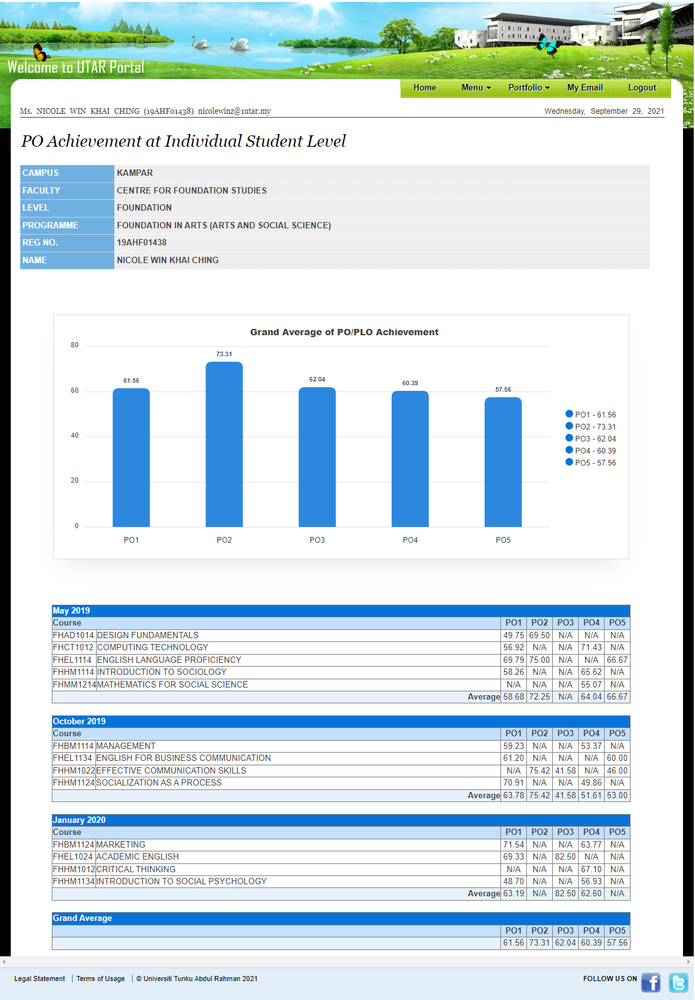
Example: Foundation Level
EXAMPLE
EXAMPLE
**You can also check your accumulated PO scores via UTAR (Student) Portal.

Slide 19
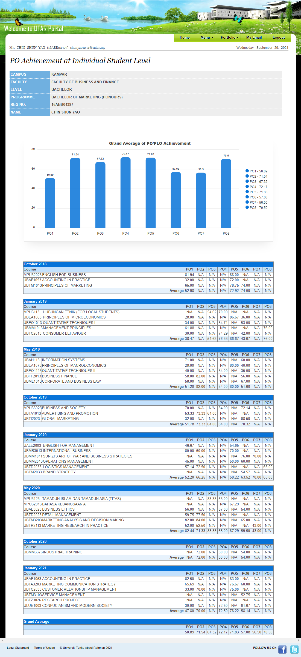
Example: Bachelor Level
EXAMPLE
EXAMPLE
**You can also check your accumulated PO scores via UTAR (Student) Portal.

Slide 20
Thank you!

