Slide 1
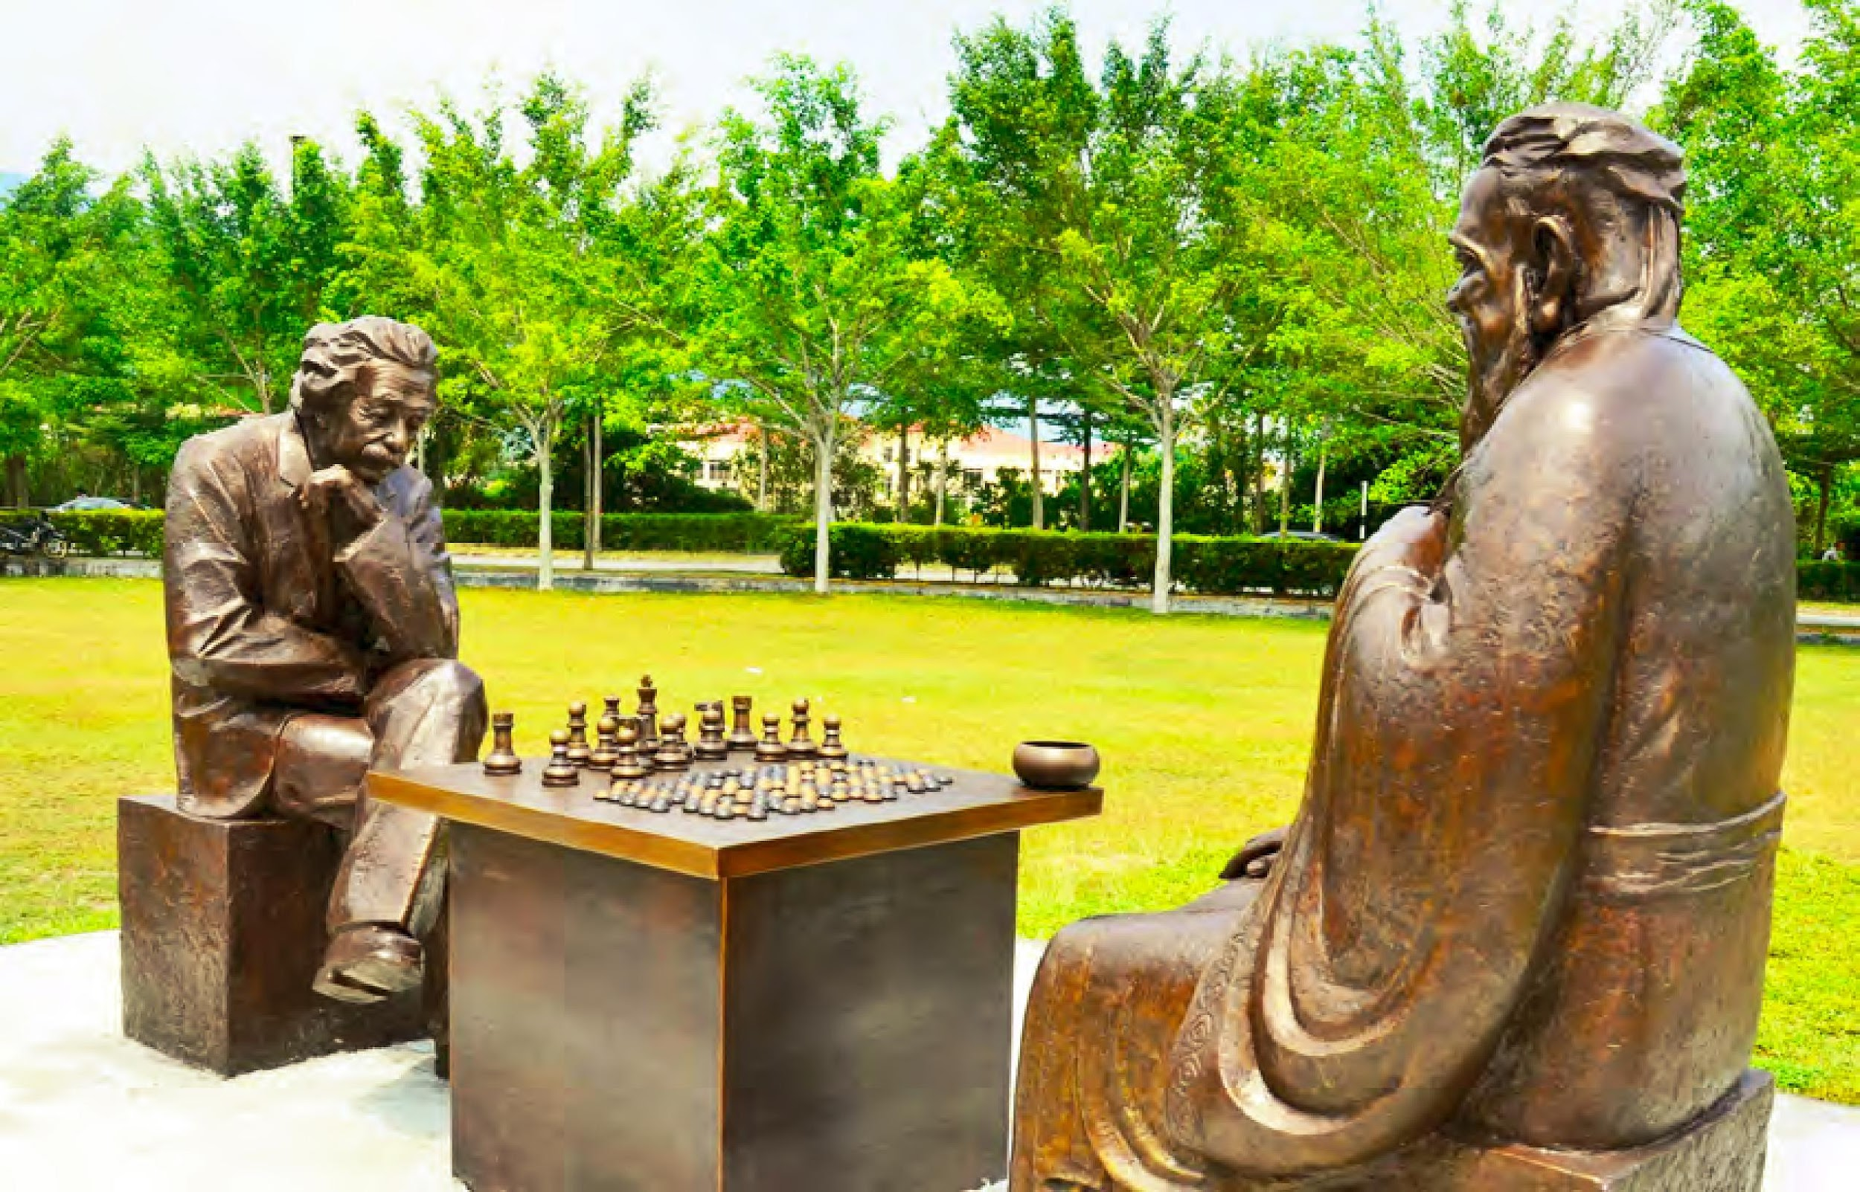
OBE briefing for students
Lee Kong Chian Faculty of Engineering & Science
How much can you learn about OBE?
Prepared by:
OBEC, LKC FES

Slide 2
What is OBE?
Lee Kong Chian Faculty of Engineering & Science

Slide 3
Lee Kong Chian Faculty of Engineering & Science
OBE is Outcome-Based Education.
OBE is an approach that focuses on the attainment of learning outcomes.
It focuses on what is essential for students to be able to do successfully at the end of their learning experiences.

Slide 4
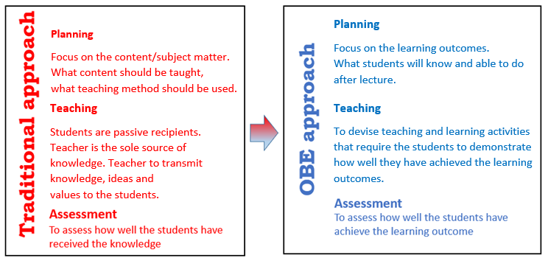
Lee Kong Chian Faculty of Engineering & Science
Why is OBE needed?
OBE is a systematic approach in curriculum delivery that focuses on a set of intended goals.
Based on student-centered learning philosophy that focuses on empirically measuring student performance, which are called outcomes.
An approach that fosters the spirit of Continuous Quality Improvement (CQI)
4
Notes:
.

Slide 5
Lee Kong Chian Faculty of Engineering & Science
Also, OBE is a requirement from qualification bodies / professional bodies such as MQA, MOHE, BEM and EAC

Slide 6
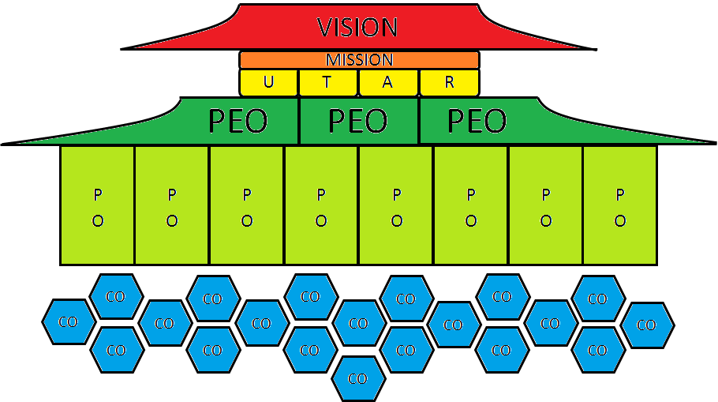
Lee Kong Chian Faculty of Engineering & Science
UTAR OBE framework
Professional Level
Programme Level
Course Level

Slide 7
Lee Kong Chian Faculty of Engineering & Science
Vision of UTAR:
To be a global university of educational and research excellence with transformative societal impact.
Mission of UTAR:
Universal values in our beliefs (M1)
Tenacity and resilience in overcoming challenges (M2)
Agility in facing new frontiers (M3)
Responsibility and commitment in pursuit of excellence (M4)

Slide 8
Lee Kong Chian Faculty of Engineering & Science
What are the Outcomes?
Programme Educational Objectives (PEOs) describe the career and professional accomplishments of graduates within 3-5 years after graduation.
Programme Outcomes (POs) describe the abilities or skills (cognitive, psychomotor and affective) that students can demonstrate at the time of graduation.
Course Outcomes (COs) are specific statements of what students are expected to KNOW and be able to PERFORM at the end of the course.
The abbreviation CO and CLO can be used interchangeably for Course Learning Outcome. Similarly, the abbreviation PO and PLO can be used interchangeably for Program Learning Outcome

Slide 9
Programme Educational Objectives (PEOs) describe the career and professional accomplishments of graduates within 3-5 years after graduation.
Lee Kong Chian Faculty of Engineering & Science
The PEOs of Bachelor of Electrical and Electronic Engineering with Honours are to produce:
PEO 1: Competent graduates practising in the electrical and electronic engineering industries with creativity and innovation.
PEO 2: Graduates who possess soft skills and are capable of managing effectively in diverse areas of engineering.
PEO 3: Graduates who progress professionally and ethically with awareness in sustainability issues.
EXAMPLE
*Please check your own program’s PEOs from the LKC FES website.
https://lkcfes.utar.edu.my/undergraduate-programmes/
Notes:
Update – programme name and the website of programme’s PEOs

Slide 10
Programme Outcomes (POs) describe the abilities or skills (cognitive, psychomotor and affective) that students can demonstrate at the time of graduation.
Lee Kong Chian Faculty of Engineering & Science
PO1
Engineering Knowledge
PO5
Tool Usage
PO9
Communication
PO3
Design/ Development of Solutions
PO7
Ethics
PO11
Life long Learning
PO2
Problem Analysis
PO6
The Engineer and the World
PO10
Project Management and Finance
PO4
Investigation
PO8
Individual and Collaborative Team Work
**These POs are for engineering programs.
Please check science program’s POs from the LKC FES website
https://lkcfes.utar.edu.my/undergraduate-programmes/
Notes:
Update – PO11 Life Long learning and the website

Slide 11
Mapping of PO to PEO
Lee Kong Chian Faculty of Engineering & Science
EXAMPLE
PEO | Programme Outcomes (PO)
 | PO 1 | PO 2 | PO 3 | PO 4 | PO 5 | PO 6 | PO 7 | PO 8 | PO 9 | PO 10 | PO 11
PEO 1 | √ | √ | √ | √ | √
PEO 2 |  |  |  |  |  |  |  | √ | √ | √
PEO 3 |  |  |  |  |  | √ | √ |  |  |  | √
Notes:
Update – PO to PEO mapping

Slide 12
Course Outcomes (COs) are specific statements of what students are expected to KNOW and be able to PERFORM at the end of the course.
Lee Kong Chian Faculty of Engineering & Science
UEEA1333 Analogue Electronics
CO1 - Explain the function and operation of phase-locked loop, negative feedback, ADC, DAC, logarithmic amplifier and analogue multiplier.
CO2 - Evaluate the effects caused by the limitations of practical op-amps.
CO3 - Design wave shaping circuits, oscillators, filters and voltage regulators.
CO4 - Analyze different types and classes of power amplifiers.
EXAMPLE
**Please check each course’s CO from course syllabus in the portal

Slide 13
Mapping of CO to PO
Lee Kong Chian Faculty of Engineering & Science
CO | Programme Outcomes (PO)
 | PO 1 | PO 2 | PO 3 | PO 4 | PO 5 | PO 6 | PO 7 | PO 8 | PO 9 | PO 10 | PO 11
CO 1 | √
CO 2 |  |  |  | √
CO 3 |  |  | √
CO 4 |  | √
EXAMPLE
Each CO contributes to the achievement of PO via curriculum design, course delivery and assessment tasks that are most appropriate to attain that CO.

Slide 14
Assessment to CO Mapping
Lee Kong Chian Faculty of Engineering & Science
EXAMPLE
All COs will be assessed, regardless of students’ choice of answering optional questions in continuous assessment and final examination. Each assessment task/question is mapped to ONE CO only.

Slide 15
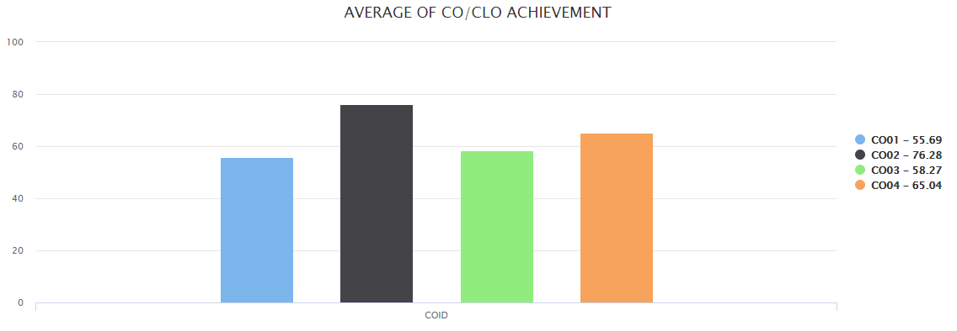
CO Achievement (Performance indicator of students for lecturers to do Continual Quality Improvement on the course)
Lee Kong Chian Faculty of Engineering & Science
Target
50%
EXAMPLE

Slide 16
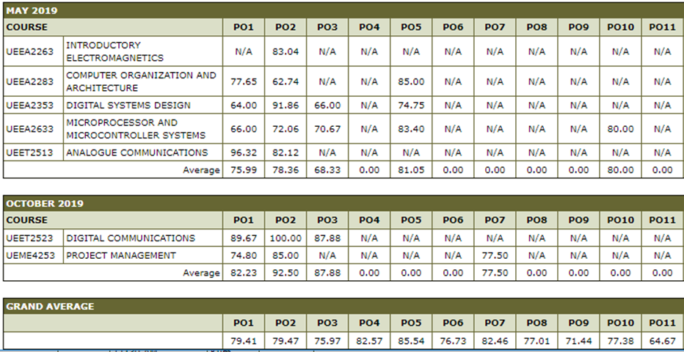
Individual PO Achievement (to date)
Lee Kong Chian Faculty of Engineering & Science
EXAMPLE
**You can check with your Academic Advisor every trimester on your accumulated PO scores.

Slide 17
Individual PO Achievement (to date)
Lee Kong Chian Faculty of Engineering & Science
EXAMPLE
**You can also check your accumulated PO scores via UTAR (Student) Portal.

Slide 18
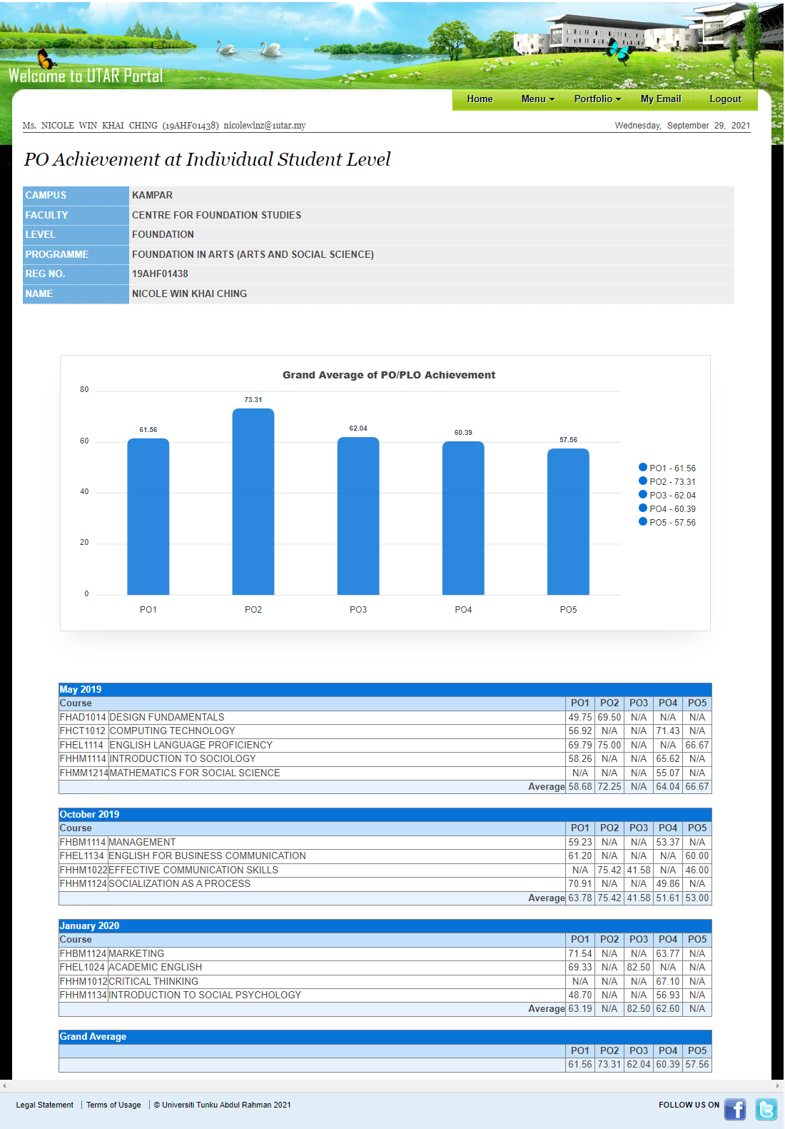
Example: Foundation Level
EXAMPLE
EXAMPLE
**You can also check your accumulated PO scores via UTAR (Student) Portal.

Slide 19
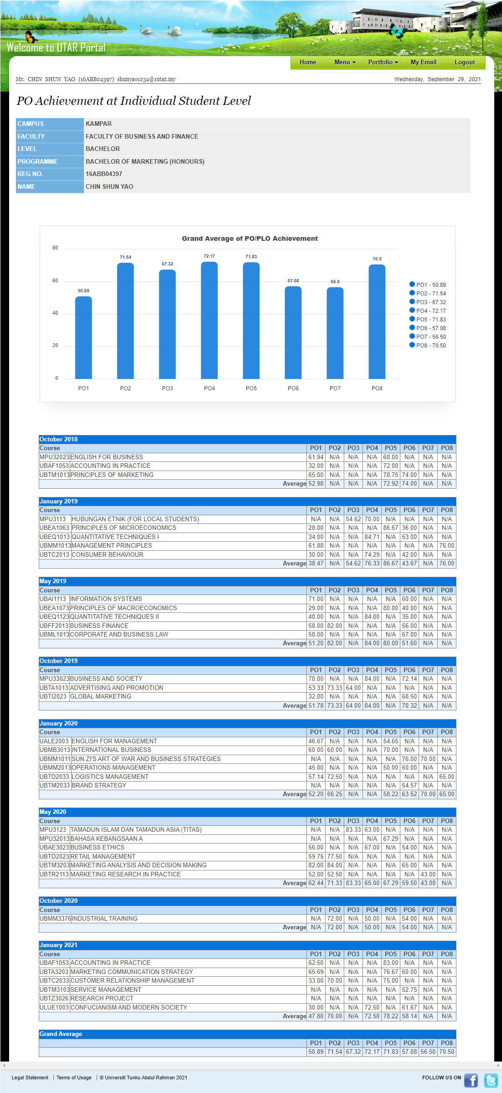
Example: Bachelor Level
EXAMPLE
EXAMPLE
**You can also check your accumulated PO scores via UTAR (Student) Portal.

Slide 20
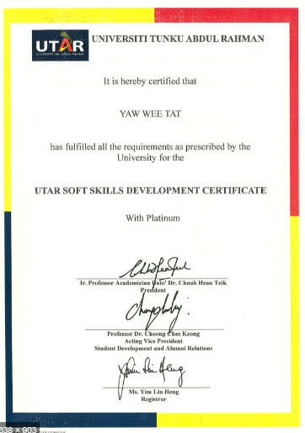
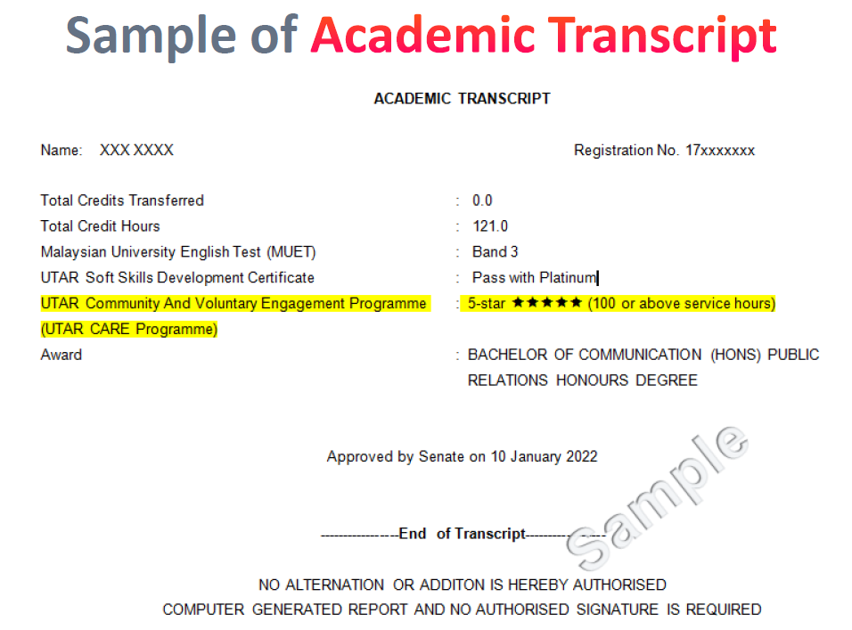
Reminder from Student Development Committee (SDC) LKC FES
Lee Kong Chian Faculty of Engineering & Science
1. E-Log Card Point: for Engineering students only, to be converted to 5 marks thereafter for Year-3 Integrated Design Project/Capstone Project.
PO11 Life-long Learning (Engineering)
2. UTAR Soft Skills Development Certificate (USSDC): a certification system to recognise students’ achievements and efforts in soft skills development. Please complete the registration in student portal ASAP.
3. UTAR CARE Programme (Community And Voluntary Engagement): A new grading system as a summary of a student’s achievement toward community engagement. Please complete the registration in student portal ASAP.

Slide 21
For more details, please click the icon to visit the specific website
Lee Kong Chian Faculty of Engineering & Science
https://lkcfes.utar.edu.my/
Announcements by FGO
Standard operating procedures (SOP)
Student Exchange Programmes (SEP)
Academic Advisor
Internal and external financial aid
Outcome based education (OBE)

Slide 22
END!
Lee Kong Chian Faculty of Engineering & Science

